Slide 1
Parallelized Payment Fraud Detection System
CSYE7105 Final Project
Team 8 – Hemant Gaikwad
Professor: Handan Liu

Slide 2
Introduction
Background
Despite the increasing convenience of online and mobile payments, people still face a significant risk of payment fraud.
Motivation
The increasing complexity of payment transactions and the evolving tactics of fraudsters drive the need for more secure and reliable payment processing services to safeguard both time and money.

Slide 3
Data Description
This dataset (481.96 MB) contains historical information about fraudulent transactions, its basic information is as follows：
Data Size 6362620 rows × 11 columns
Data Types int64(×3) / float64(×5) / object(×3)
Target "isFraud" (1/0)
Features
step time units, 1 step = 1 hour
type type of online transaction (payment / transfer / ...)
amount amount of the transaction
nameOrig Id of the customer starting the transaction
oldbalanceOrg balance before the transaction
newbalanceOrig balance after the transaction
nameDest name of the customer receiving the transaction
oldbalanceDest initial balance of recipient before the transaction
newbalanceDest new balance of recipient after the transaction
isFraud whether it is a fraudulent transaction?
isFlaggedFraud Is the transaction identified as fraudulent?

Slide 4
Methodology
Write a function to create metadata for the initial data.
Executing the function serially.
Execute the function in parallel using Multiprocessing Pool and Multiprocessing Process, respectively.
Data processing and feature engineering using NumPy Array and Pandas.
Data processing and feature engineering using Dask Array and Dask DataFrame.
Handling imbalance data by resampling technique using Pandas and Dask.
Training the model with XGBoost.
Adjusting the model parameters by Grid Search with Multiple-GPU and Multiple-CPU.
Tesla P-100 GPU
Using K-fold cross-validation to evaluate the model with Multiple-GPU and Multiple-CPU.

Slide 5
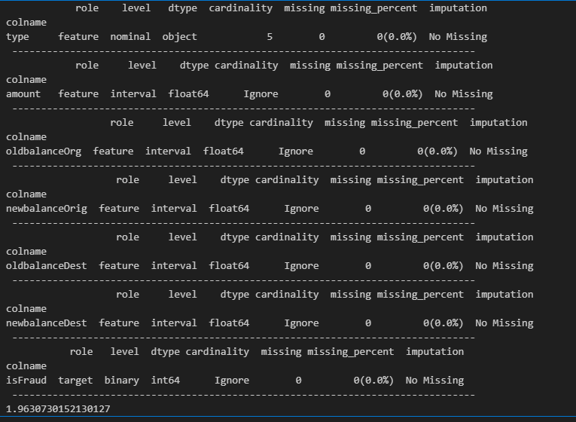
Results and Analysis
Metadata
Created Metadata, each feature as parameters, returning the name, variable type, data type, number of unique values, number of missing values, percentage of missing values and imputation method for each feature.

Slide 6
Results and Analysis
Metadata
We first tried to use the Pool method, but it did not work as well as we expected, regardless of the number of CPUs.
We analyzed that the causes might be that:
This metadata creation function does not require a lot of CPU resources to parallelize.
The slow startup time of additional processes and communication overhead.
Then, we tried using Process method

Slide 7
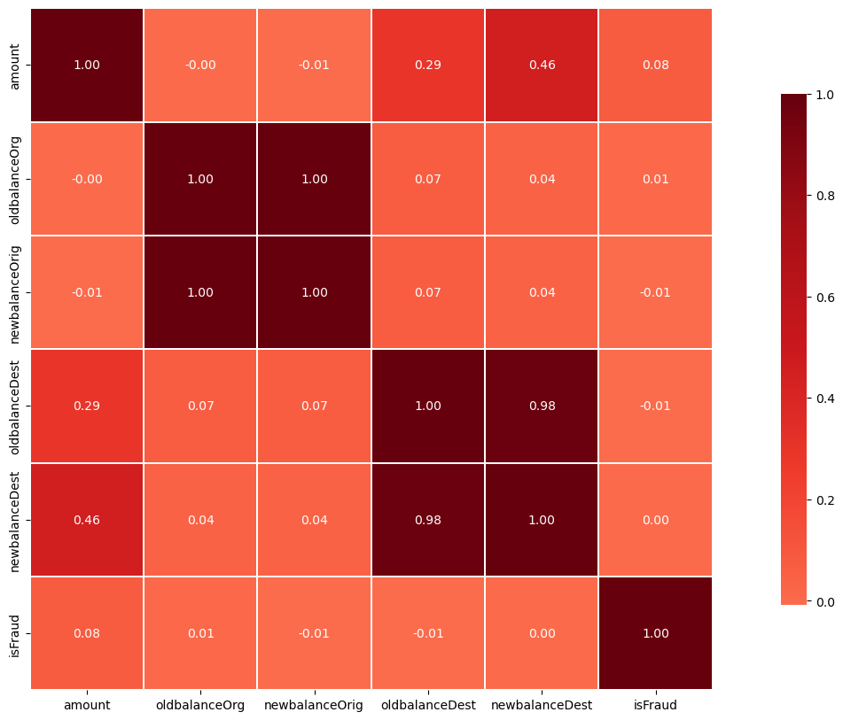
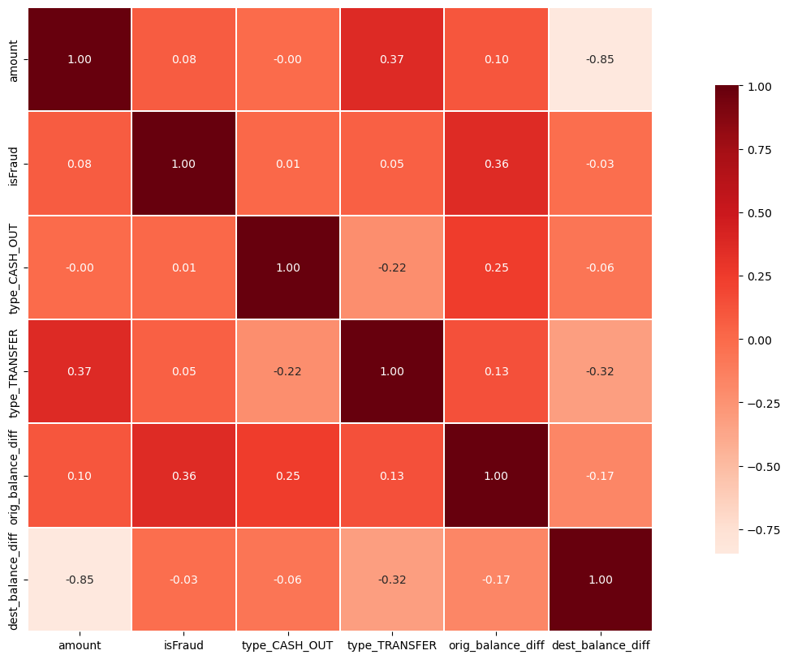
Results and Analysis
Feature Engineering
Before
After
For the nominal variable 'type', encoded using OneHotEncoder.
Calculated the balance difference before and after the transaction
Replaced the original features as new features.

Slide 8
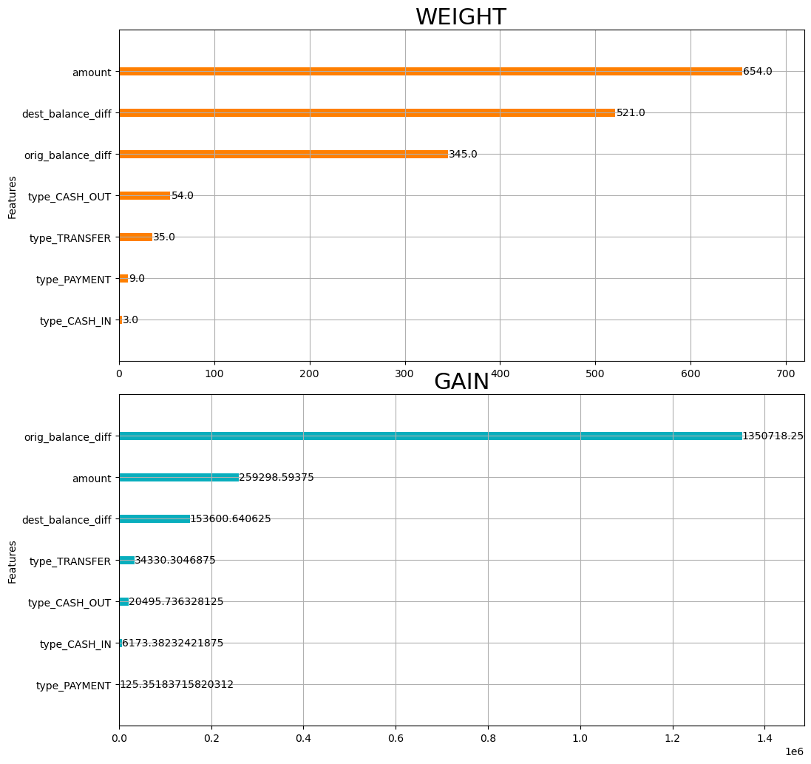
Results and Analysis
Feature Engineering
For feature selection, we plotted the feature importance graph based on weight and gain, and selected five features based on comprehensive consideration.

Slide 9
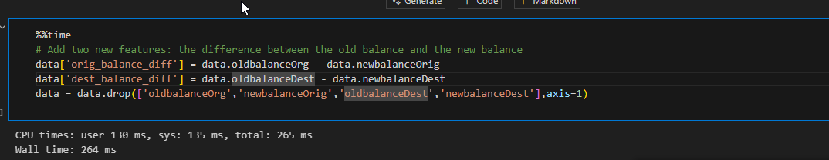
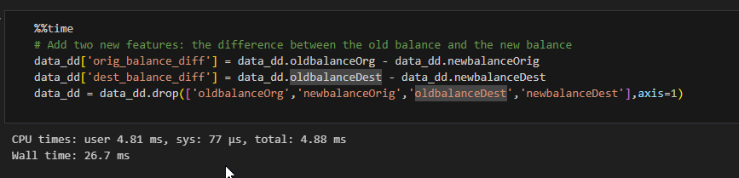
Results and Analysis
Feature Engineering
When we switch from NumPy Array to Dask Array, the feature construction(simple calculations) is more than 10 times faster.

Slide 10
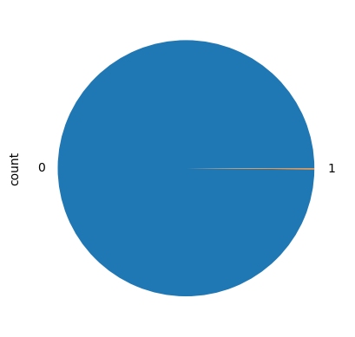
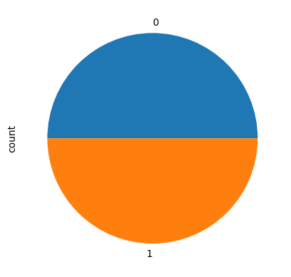
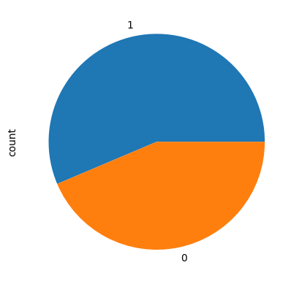
Results and Analysis
Resampling
Not Fraud: 6354407 Is Fraud: 8213
Ratio: 773.7 : 1
Not Fraud: 6354407
Is Fraud: 6354407
Ratio: 1.0 : 1
Not Fraud: 6354
Is Fraud: 8213
Ratio: 0.77 : 1
Before
After Oversampling
After Undersampling
Data was extremely unbalanced, we employ resampling techniques (both oversampling and undersampling) to process our data.

Slide 11
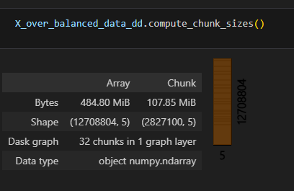
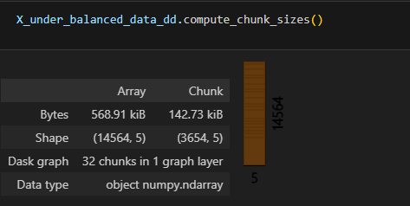
Results and Analysis
Resampling
After Undersampling
After Oversampling
Got the balanced data. For the Dask part, we adjust chunksize to an appropriate size.
Since the size of data after using undersampling is too small and its chunksize is also very small, we decided to use only the balanced data obtained after oversampling as the final data.

Slide 12
Results and Analysis
Model Training
Number of GPU or CPU | GPU or CPU | Execution Time (Seconds) | Valid Accuracy | Method
1 | GPU | 311.43 | 0.98 | Pandas, MultiProcessing
2 | GPU | 311.10 | 0.98 | Pandas, MultiProcessing
3 | GPU | 310.57 | 0.98 | Pandas, MultiProcessing
4 | GPU | 310.59 | 0.98 | Pandas, MultiProcessing
5 | GPU | 311.26 | 0.98 | Pandas, MultiProcessing
6 | GPU | 310.74 | 0.98 | Pandas, MultiProcessing
7 | GPU | 310.44 | 0.98 | Pandas, MultiProcessing
8 | GPU | 312.69 | 0.98 | Pandas, MultiProcessing
Number of GPU or CPU | GPU or CPU | Execution Time | Valid Accuracy | Method
1 | CPU | 5147.8 | 0.981 | Pandas, MultiProcessing
2 | CPU | 1725.51 | 0.981 | Pandas, MultiProcessing
3 | CPU | 1262.30 | 0.981 | Pandas, MultiProcessing
4 | CPU | 976.16 | 0.981 | Pandas, MultiProcessing
5 | CPU | 1213.38 | 0.981 | Pandas, MultiProcessing
6 | CPU | 1040.48 | 0.981 | Pandas, MultiProcessing
7 | CPU | 923.97 | 0.981 | Pandas, MultiProcessing
8 | CPU | 832.95 | 0.981 | Pandas, MultiProcessing

Slide 13
Results and Analysis
Model Training
Number of GPU or CPU | GPU or CPU | Execution Time (Seconds) | Valid Accuracy | Method
1 | GPU | 216.55 | 0.981 | Dask, Multiprocessing
2 | GPU | 127.18 | 0.981 | Dask, MultiProcessing
3 | GPU | 132.81 | 0.981 | Dask, MultiProcessing
4 | GPU | 124.83 | 0.981 | Dask, MultiProcessing
5 | GPU | 122.36 | 0.981 | Dask, MultiProcessing
6 | GPU | 122.02 | 0.981 | Dask, MultiProcessing
7 | GPU | 124.83 | 0.981 | Dask, MultiProcessing
8 | GPU | 124.67 | 0.981 | Dask, MultiProcessing
Number of GPU or CPU | GPU or CPU | Execution Time (Seconds) | Valid Accuracy | Method
1 | CPU | 3886.0 | 0.981 | Dask, Multiprocessing
2 | CPU | 1295.25 | 0.981 | Dask, MultiProcessing
3 | CPU | 2508.06 | 0.981 | Dask, MultiProcessing
4 | CPU | 302.21 | 0.981 | Dask, MultiProcessing
5 | CPU | 489.18 | 0.981 | Dask, MultiProcessing
6 | CPU | 401.70 | 0.981 | Dask, MultiProcessing
7 | CPU | 393.15 | 0.981 | Dask, MultiProcessing
8 | CPU | 389.57 | 0.981 | Dask, MultiProcessing

Slide 14
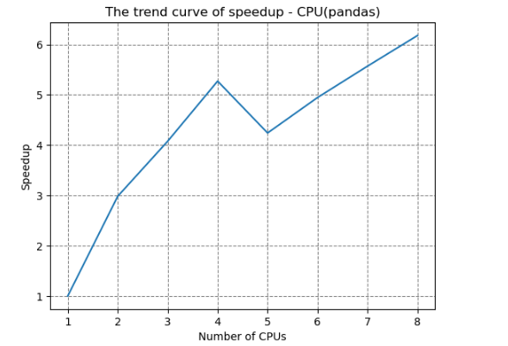
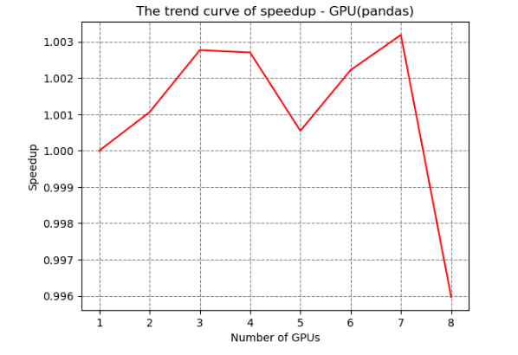
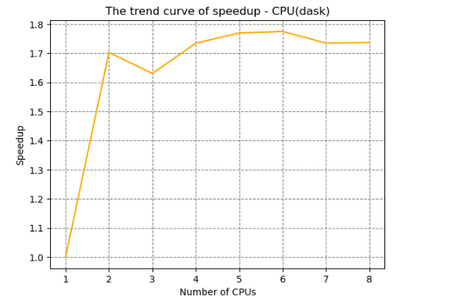
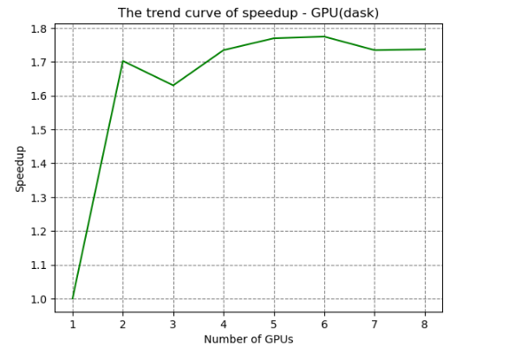
Results and Analysis
Speedup
Only in the case of using Dask or pandas and multiprocessing method on multiple-gpu, the speedup has an obvious upward trend. All other parallel acceleration effects are not obvious or even decline, especially when the number of CPUs is more than 4.
But in general, the GPU speedup is much better than the CPU, and the overall speedup of Dask is also much better than pandas.

Slide 15
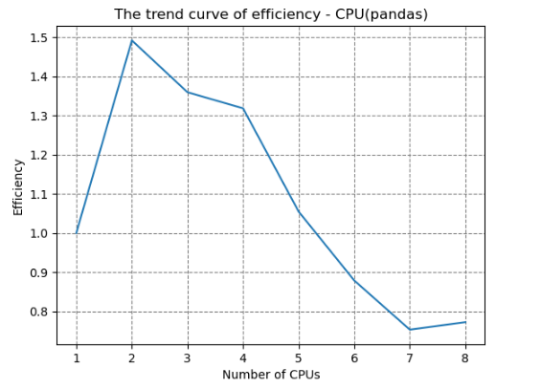
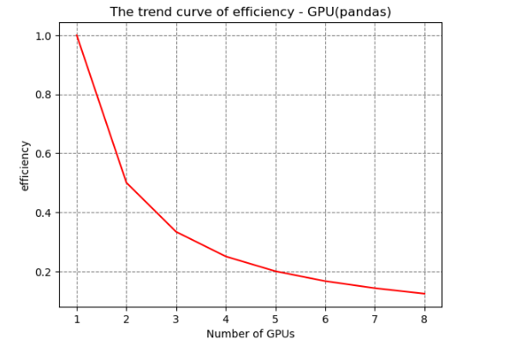
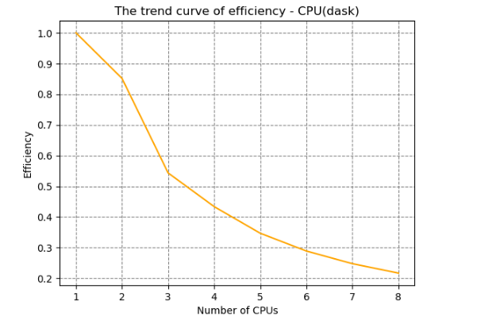
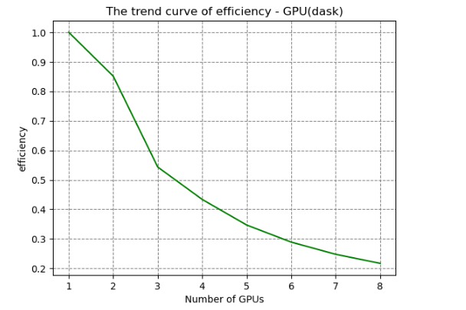
Results and Analysis
Eficiency
The efficiency of all experiments shows a decreasing trend with the increase of the number of parallel cores, indicating that our parallel method may not be able to make good use of CPU and GPU resources.

Slide 16
Results and Analysis
Model Training
Analysis of poor performance of Speedup and Efficiency
It's not always guaranteed that we can use the all the recources when run the program on the cluster.
Some parts of model training or parameter adjusting, or cross-validation do not support Dask or multiprocessing for parallel processing.
For the data processing itself, the CPU of a single process can handle it well and does not need additional parallel operations. Parallel operations themselves will bring more resource consumption and computing time
Some data processing inevitably uses a mix of pandas and Dask, because the latest Dask does not fully support some pandas operations. Although the local impact of this time is very small, it may affect the overall effect of Dask lazy calculation.
The compute () method is repeatedly called, which may have a performance poor effect.
Do not adjust the chunk size to an optimal value.

Slide 17

Conclusions
When using multiprocessing to parallelize a function, the cost of overhead needs to be considered, otherwise it may not be as effective as serial execution.
Proper use of Dask Array can significantly improve the computation time of NumPy Array.
Optimal results only considering the running speed is to use Dask and multiprocessing to run on 4 GPU because the whole efficiency is low.
For our model parallelism is better on multiple-gpu than on multiple-cpu.
The speedup of Dask is good on both multiple-gpu and multiple-cpu but the speedup of multiple-gpu is more significant.

Slide 18
References
Fadyesam. “Online Fraud EDA and Prediction with Accuracy 99%.” Kaggle, Kaggle, 30 Oct. 2022, https://www.kaggle.com/code/fadyesam/online-fraud-eda-and-prediction-with-accuracy-99.
guest_blog. “Imbalanced Classification: Handling Imbalanced Data Using Python.” Analytics Vidhya, 30 Nov. 2022, https://www.analyticsvidhya.com/blog/2020/07/10-techniques-to-deal-with-class-imbalance-in-machine-learning/.
Bahgat, Karim, et al. “Multiprocessing.pool() Slower than Just Using Ordinary Functions.” Stack Overflow, 1 Feb. 1961, https://stackoverflow.com/questions/20727375/multiprocessing-pool-slower-than-just-using-ordinary-functions.
Radečić, Dario. “Dask Arrays - How to Parallelize Numpy with Ease.” Medium, Towards Data Science, 23 Mar. 2022, https://towardsdatascience.com/dask-arrays-how-to-parallelize-numpy-with-ease-b33d7e9dcb59#:~:text=That's%20where%20Dask%20arrays%20provide,deal%2Dbreaker%20for%20some%20cases.
N'Wuitcha, Badji. “How Is Multiprocessing Different from Parallel Computing in Python?” Medium, Better Programming, 22 Oct. 2022, https://betterprogramming.pub/how-is-multiprocessing-different-from-parallel-computing-in-python-4b375c29b183.
Dhariwal, Kunal. “Pandas with Dask, for an Ultra-Fast Notebook.” Medium, Towards Data Science, 31 Oct. 2021, https://towardsdatascience.com/pandas-with-dask-for-an-ultra-fast-notebook-e2621c3769f.
Sravanti TatirajuI have been in the IT industry from 9 years. I worked as a curriculum validation engineer at Oracle for the past 5 years validating various courses on products developed by them. Before Oracle. “Optimize Running Large Number of Tasks Using Dask.” Qxf2 BLOG, 23 Mar. 2021, https://qxf2.com/blog/optimize-running-large-number-of-tasks-using-dask/.
Cavanaugh, Gus. “Quick and Dirty DataFrame Processing with CPU & GPU Clusters in the Cloud.” Medium, Medium, 29 Oct. 2021, https://medium.com/@GusCavanaugh/quick-and-dirty-dataframe-processing-with-cpu-gpu-clusters-in-the-cloud-c50d0ecfba92.

Slide 19
Thank you!

